Slide 1
Chapter 2 Digital Image Fundamentals

Slide 2
Chapter 2 Digital Image Fundamentals
2.1 Elements of Visual Perception
2.2 Light & EM Spectrum
2.3 Image Sensing & Acquisition

Slide 3
2.3.4 A simple Image Formation Model
f(x,y) = i(x,y) r(x,y)
i(x,y): illumination components, 0<i(x,y)<∞
r(x,y): reflectance components, 0<r(x,y)<1

Slide 4
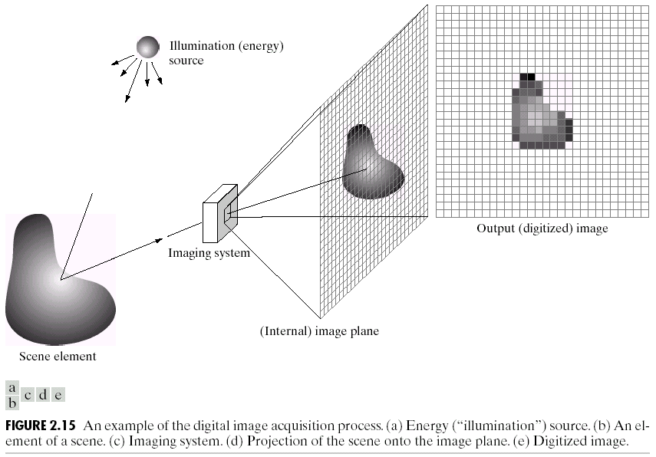
2.4.1 Basic Concept in Sampling & Quantization

Slide 5
2.4.1 Basic Concept in Sampling & Quantization

Slide 6
2.4.1 Basic Concept in Sampling & Quantization

Slide 7
2.4.2 Representing Digital Image
Matrix or 2-D Array

Slide 8
2.4.3 Spatial & Intensity Resolution
Spatial Resolution
Line pairs per unit distance
Dots (pixels) per unit distance
Dpi: dot per inch
Spatial resolution is a measure of the accuracy or detail of a graphic display, expressed as dots per inch, pixels per inch, lines per inch, etc.

Slide 9
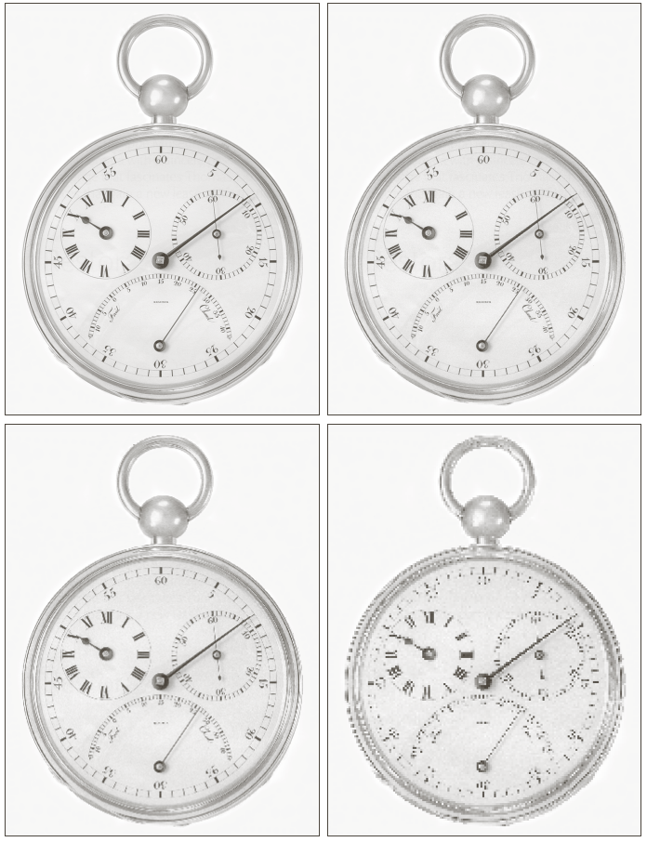
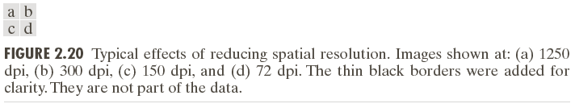
Spatial Resolution

Slide 10

Exercise
10 inch , 1024 X 768
Spatial Resolution =?

Slide 11
Exercise
Diagonal length = 10 inch

Slide 12
2.4.3 Spatial & Intensity Resolution
Intensity Resolution
Intensity Level
Usually is an integer power of two
8 bits
HDMI 1.3 support 10bits,12bits,16bits for each color component (channel)

Slide 13
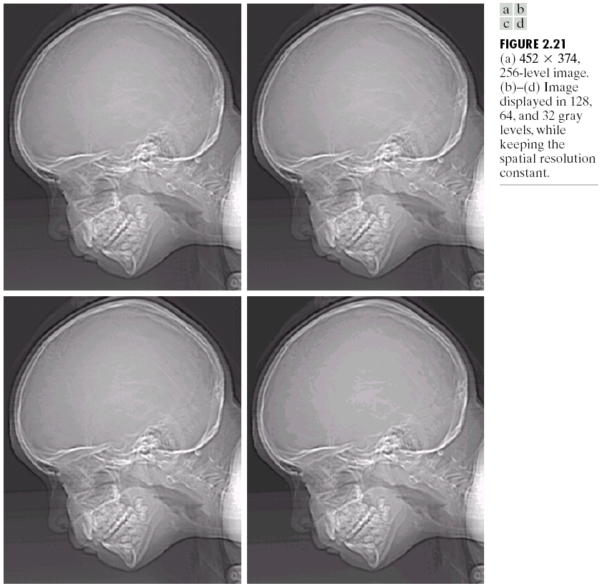
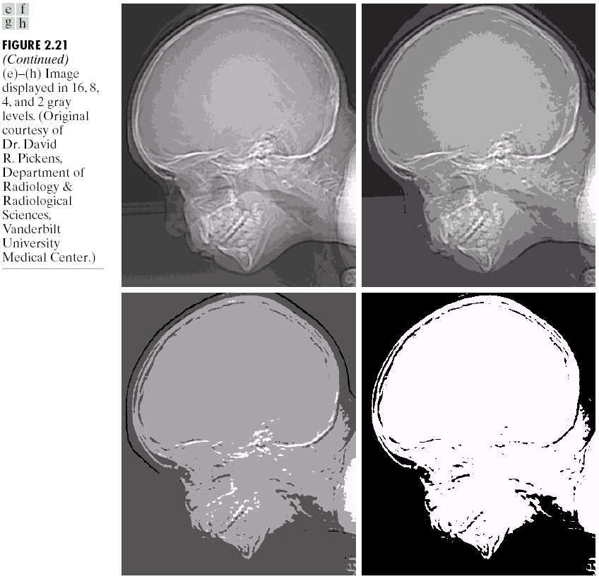
Intensity Resolution

Slide 14
Intensity Resolution
How to get n-bits image?
7 bit | 6 bit | 5 bit | 4 bit | 3 bit | 2 bit | 1 bit | 0 bit
>>
0 | 0 | 7 bit | 6 bit | 5 bit | 4 bit | 3 bit | 2 bit

Slide 15
Intensity Resolution
[Programming]
Exercise:
byte[,] get_n_bits_image(byte[,] f,int n);

Slide 16
2.5 Same Basic Relationship between pixels

Slide 17
2.5.1 Neighbors of a pixel

Slide 18
2.5.1 Neighbors of a pixel
p: (x,y)
4-Neighbors of p:
N4 (p) = {(x+1,y),(x-1,y),(x,y+1),(x,y-1)}

Slide 19
2.5.1 Neighbors of a pixel
p: (x,y)
D-Neighbors (Diagonal -Neighbors)of p:
ND (p) = {(x+1,y+1),(x-1,y+1), (x+1,y-1),(x-1,y-1)}

Slide 20
2.5.1 Neighbors of a pixel
p: (x,y)
8-Neighbors of p:
N8 (p) = N4 (p) U ND (p)

Slide 21
2.5.2 Adjacency, Connectivity, Region and Boundaries
Adjacency
Binary image: Intensity {0,1}
Usually 0 means background and 1 means foreground
0 | 0 | 0 | 0 | 0 | 0 | 0 | 0
0 | 0 | 0 | 0 | 0 | 0 | 0 | 0
0 | 0 | 0 | 1 | 1 | 0 | 0 | 0
0 | 0 | 1 | 1 | 1 | 1 | 0 | 0
0 | 0 | 1 | 1 | 1 | 1 | 0 | 0
0 | 0 | 1 | 1 | 1 | 1 | 0 | 0
0 | 0 | 0 | 0 | 0 | 0 | 0 | 0
0 | 0 | 0 | 0 | 0 | 0 | 0 | 0

Slide 22
Adjacency
Both p and q are in the foreground (V:{1})
4-adjacency: q in N4(p)
8-adacency: q in N8(p)
m-adjacency (mixed adjacency)
q in N4(p) or
q in N8(p) and the set N4(p) ∩ N4(q) has no pixels whose value are from V(V:{1})

Slide 23
Adjacency
m-adjacency (mixed adjacency)
q in N4(p) or
q in N8(p) and the set N4(p) ∩ N4(q) has no pixels whose value are from V(V:{1})
0
0 |  | 0
0 | 0
0 | 1 | 1
0 | 1 | 0
0 | 0 | 1

Slide 24
m-Adjacency
0 | 0 | 0 | 0
0 |  |  | 0
0 |  | 0 | 0
0 | 0 |  | 0
p: (yellow), q: (green)
Blue background pixel means
set N4(p) ∩ N4(q)
m-adjacency (mixed adjacency)
q in N4(p) or
q in N8(p) and the set N4(p) ∩ N4(q) has
no pixels whose value are from V(V:{1})
0 | 0 | 0 | 0
0 |  |  | 0
0 |  | 0 | 0
0 | 0 |  | 0
0
0 |  | 0
0 | 0

Slide 25
m-Adjacency
p: (yellow), q: (blue)
Blue background pixel means
set N4(p) ∩ N4(q)
m-adjacency (mixed adjacency)
q in N4(p) or
q in N8(p) and the set N4(p) ∩ N4(q) has
no pixels whose value are from V(V:{1})
0
0 |  | 0
0 | 0

Slide 26
[Programing]
bool Is _4adjacent(int px,int py,int qx,int qy);
bool Is _8adjacent(int px,int py,int qx,int qy);
Bool Is_m_adjacent(byte[,]f, int px,int py,int qx,int qy);

Slide 27
Digital Path
Digital Path from pixel p to pixel q is a sequence of distinct pixels with coordinates (x0,y0),(x1,y1),…,(xn,yn) where (xi-1,yi-1) and (xi,yi) are adjacent, i: [1..n]

Slide 28
Digital Path
 |  | p6 | p7 | p8 | p9=q
 | p5
 | p4
 | p3
 | p2
 |  | p1 | p0=p

Slide 29
Digital Path (Closed)
 |  | p6 | p7 | p8 | p9
 | p5 |  |  |  | p10
 | p4 |  |  |  | p11
 | p3 |  |  |  | p12
 | p2 |  |  | P13=q
 |  | p1 | p0=p

Slide 30
Connected Set (Region)

Slide 31
Connected Set (Region)
 |  |  |  |  |  |  | q
 |  |  |  | q
 | p |  |  |  |  | P
S1
S2

Slide 32
Adjacent Regions
If Ri U Rj is a connected set, Ri and Rj ara adjacent regions.
Ri
Rj

Slide 33
Disjoint Regions
Not Adjacent

Slide 34
Foreground / Background
F
B

Slide 35
Foreground / Background
K disjoint regions, Rk, k=1,2,..,K
Ru = R1 U R2 U … U RK
(Ru)c , c means complement
Foreground : Ru
Background: (Ru)c

Slide 36
Foreground / Background
F ： Ru
B: (Ru)c

Slide 37
Boundary (Border /Contour) of Region
Inner Border of Region
B(in) = {(x,y)|(x,y)∈R, (x,y) adjacent to (R) c}
 |  | p4 | p5 | P6 | p7 | p8
 |  | P3 |  |  |  | p9
 |  | P2 |  | p12 | p11 | p10
 |  | P1 |  | p13
 |  | p0 | p15 | p14

Slide 38
Exercise: byte[,] getInnerBorder(byte[,]f)
Intput: f is a binary image, 0 means background and 255 means foreground (regions)
Output: binary image. 255 means inner borders of the regions in input image

Slide 39
Boundary (Border /Contour) of Region
Inner Border of Region

Slide 40
Exercise: byte[,] getOuterBorder(byte[,]f)
Outer Border of Region
B(out) = {(x,y)|(x,y)∈ (R)c, (x,y) adjacent to R}

Slide 41
Exercise: byte[,] getOuterBorder(byte[,]f)
Intput: f is a binary image, 0 means background and 255 means foreground (regions)
Output: binary image. 255 means outer borders of the regions in input image

Slide 42
2.5.3 Distance Measure
Distance Function
p (x,y), q (s,t), z (u,v)
D(p,q)≥0, D(p,q)=0 iff p=q
D(p,q)=D(q,p)
D(p,z)≤D(p,q)+D(q,z)

Slide 43
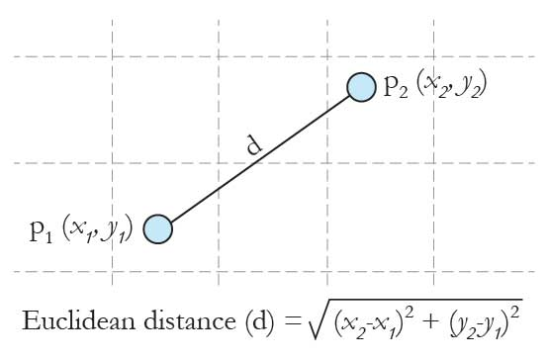
2.5.3 Distance Measure
Euclidean distance [Eu’cl[ai]dean]

Slide 44
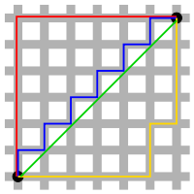
2.5.3 Distance Measure
City-block distance
D4(p, q) = │x-s│+ │y-t│ ; p:(x,y) , q(s,t)

Slide 45
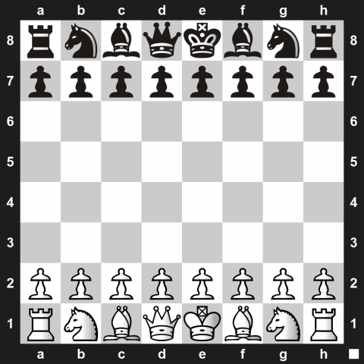

2.5.3 Distance Measure
Chessboard distance
D8(p, q) = max (│x-s│, │y-t│)
chessman: king

Slide 46
2.5.3 Distance Measure
Chessboard distance
 |  |  | q
 | P

Slide 47
Exercise
Max (De,D4,D8) = ?
Min(De,D4,D8) = ?
D4(p, q) = │x-s│+ │y-t│
D8(p, q) = max(│x-s│,│y-t│)

Slide 48
Exercise
If D4(p,q)<=K D8(p, q) is always TRUE, what is the min value of K?
D4(p, q) = │x-s│+ │y-t│
D8(p, q) = max(│x-s│,│y-t│)

Slide 49
Exercise
p: (x0,y0)
Re = { q | De(p,q)<=r}
R4 = { q | D4(p,q)<=r}
R8 = { q | D8(p,q)<=r}
Draw the sketch of Re,R4 & R8

